Slide 1

We should have
proactiveness
IMAMURA Yuto

Slide 2

01
Introduction
01

Slide 3
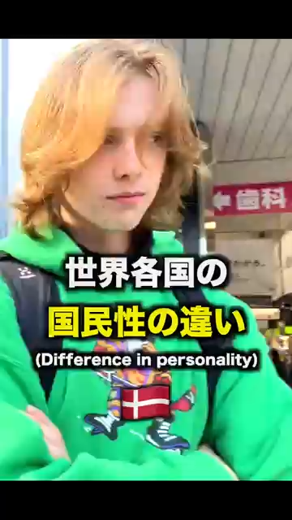


Video
・In Japan
・In Overseas
Hey, the next round of coffee is on me!
I'm so sorry!
Why do you think such a gap in perception exists?
02

Slide 4
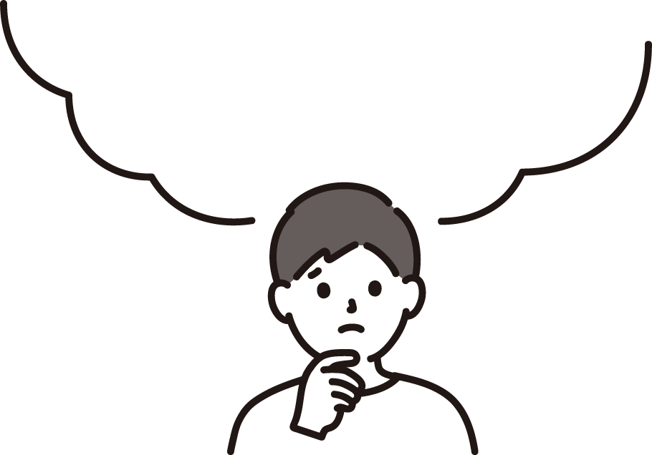
Answer
・Another sense of value.
・In American
・In Japan
・apologize means to accept my faults.
・they want to communicate smooth.
03

Slide 5


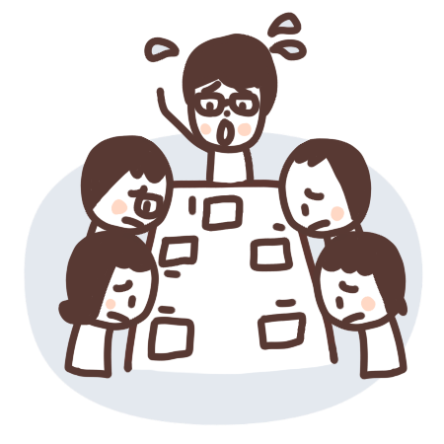
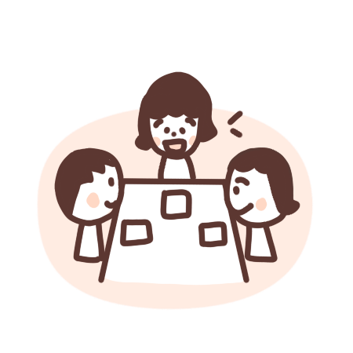

Another example
・In meeting
・In Japan
・In Overseas
we must incorporate proactiveness.
04

Slide 6
02
From an economic perspective.
05

Slide 7
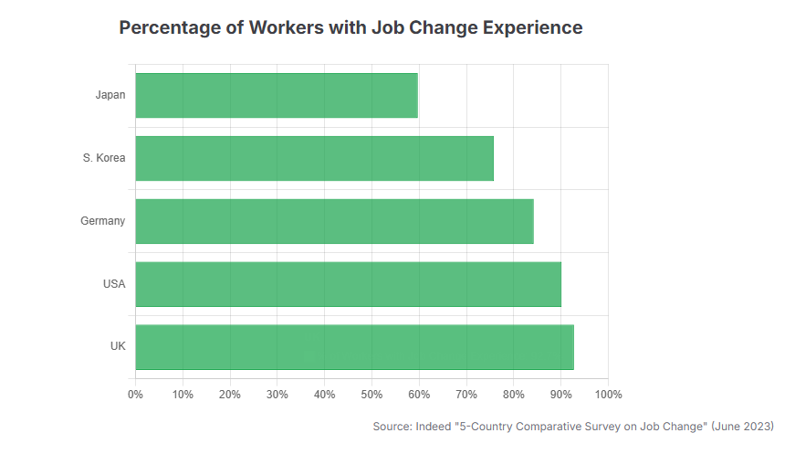
Percentage of Workers
Japan is about 60%.
America is about 90%.
UK is about 93%
・In Overseas
・In Japan
Client
・it is a standard career strategy to change workplaces.
・long-term employment at a single company is common.
KOTO
Creative
06

Slide 8
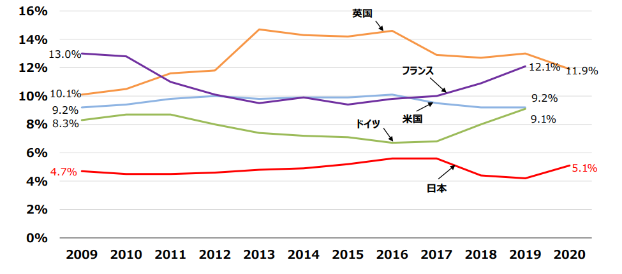
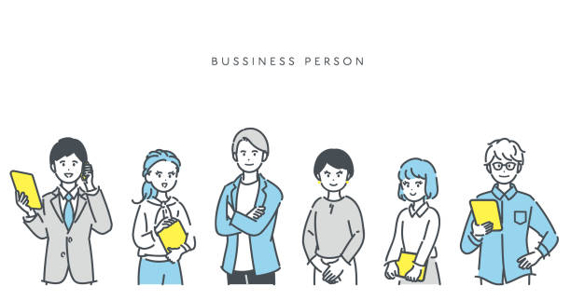
The rate of establishing a company
Japan is about 5%.
America is about 9%.
Client
Japan is about 0.4%.
Germany is about 0.8%
KOTO
Creative
07

Slide 9
03
Conclusion

